Slide 1




Agri-AI
Team ID - CU_CP_601
Aesha Shah
Rahul Pahelani
Bhaktil Chauhan

Slide 2

Project Objectives
Problem Statement
Project Overview – Introduction
End Users
Wow Factor in Project
Modelling/Block Diagram/Flow of Project
Result/outcomes
Conclusion
Future Perspective

Slide 3
Problem Statement
Despite the vital role agriculture plays in sustaining global populations, traditional farming practices often face challenges that hinder productivity and sustainability. Farmers encounter difficulties in predicting crop yields accurately, optimizing fertilizer usage, and promptly identifying and mitigating crop diseases. The lack of efficient and integrated technological solutions results in suboptimal decision-making, leading to decreased yields, increased resource wastage, and heightened susceptibility to crop-related risks.
To address these issues, there is a critical need for a comprehensive AI/ML project like AgriAI. Current farming practices lack the technological advancements required to harness the full potential of data-driven insights in agriculture. The absence of a unified platform for crop prediction, personalized fertilizer suggestions, and timely crop disease identification leaves farmers with limited tools to make informed decisions. AgriAI aims to revolutionize the agricultural landscape by providing farmers with the necessary tools to enhance productivity, optimize resource utilization, and mitigate risks, ultimately contributing to the long-term sustainability of global food production.

Slide 4
Project overview - Introduction
AgriAI is a groundbreaking project designed to revolutionize traditional agricultural practices by harnessing the power of Artificial Intelligence (AI) and Machine Learning (ML). In the face of growing global population demands and environmental challenges, AgriAI aims to empower farmers with cutting-edge technology, facilitating informed decision-making and optimizing agricultural processes.
Key Features :
Crop Prediction
Fertilizer Suggestions
Crop Disease Identification

Slide 5
End User
Farmers: Small, medium, and large-scale farmers who seek to improve their crop yields and overall farm management.
Agricultural Extension Services: Organizations providing agricultural extension services can use AgriAI to offer tailored advice and support to farmers in their region.
Government Agencies: Agricultural departments and regulatory bodies can leverage AgriAI to monitor and support the agricultural sector, plan for food security, and provide targeted assistance to farmers.
Environmental Organizations: Organizations focused on sustainable agriculture and environmental conservation can use AgriAI to promote practices that minimize environmental impact while maximizing productivity.

Slide 6
Wow Factor in Solution
Comprehensive Integration: AgriAI goes beyond offering individual solutions and brings together predictive analytics, machine learning algorithms, and image recognition into a single, cohesive platform. This comprehensive integration allows farmers to access a holistic set of tools for decision-making.
Visual Disease Identification: The incorporation of image recognition for crop disease identification introduces a visual dimension to the solution. Farmers can use their smartphones or other devices to capture images of crops, and AgriAI can rapidly analyze these visuals to identify potential diseases, allowing for timely intervention
User-friendly Interface: The project prioritizes user accessibility, ensuring that the interface is user-friendly and easily navigable for farmers with varying levels of technological expertise.
Contribution to Sustainable Agriculture: AgriAI's focus on precision agriculture not only improves yields but also promotes sustainable farming practices. By minimizing resource wastage and reducing the reliance on chemical interventions, AgriAI aligns with environmental conservation goals.

Slide 7
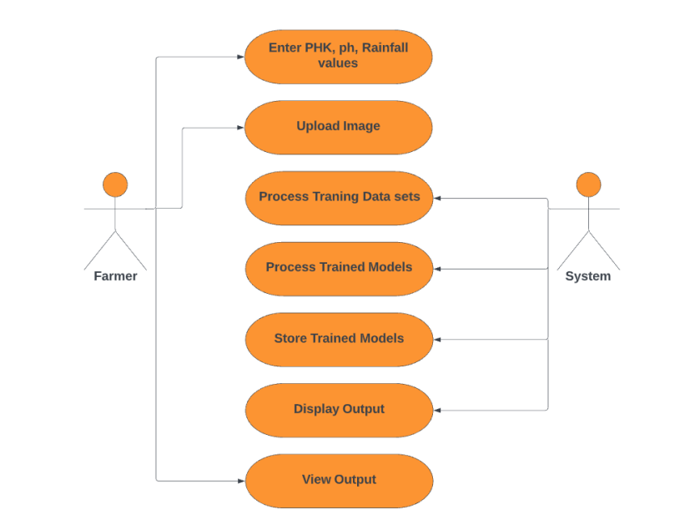
Modelling

Slide 8
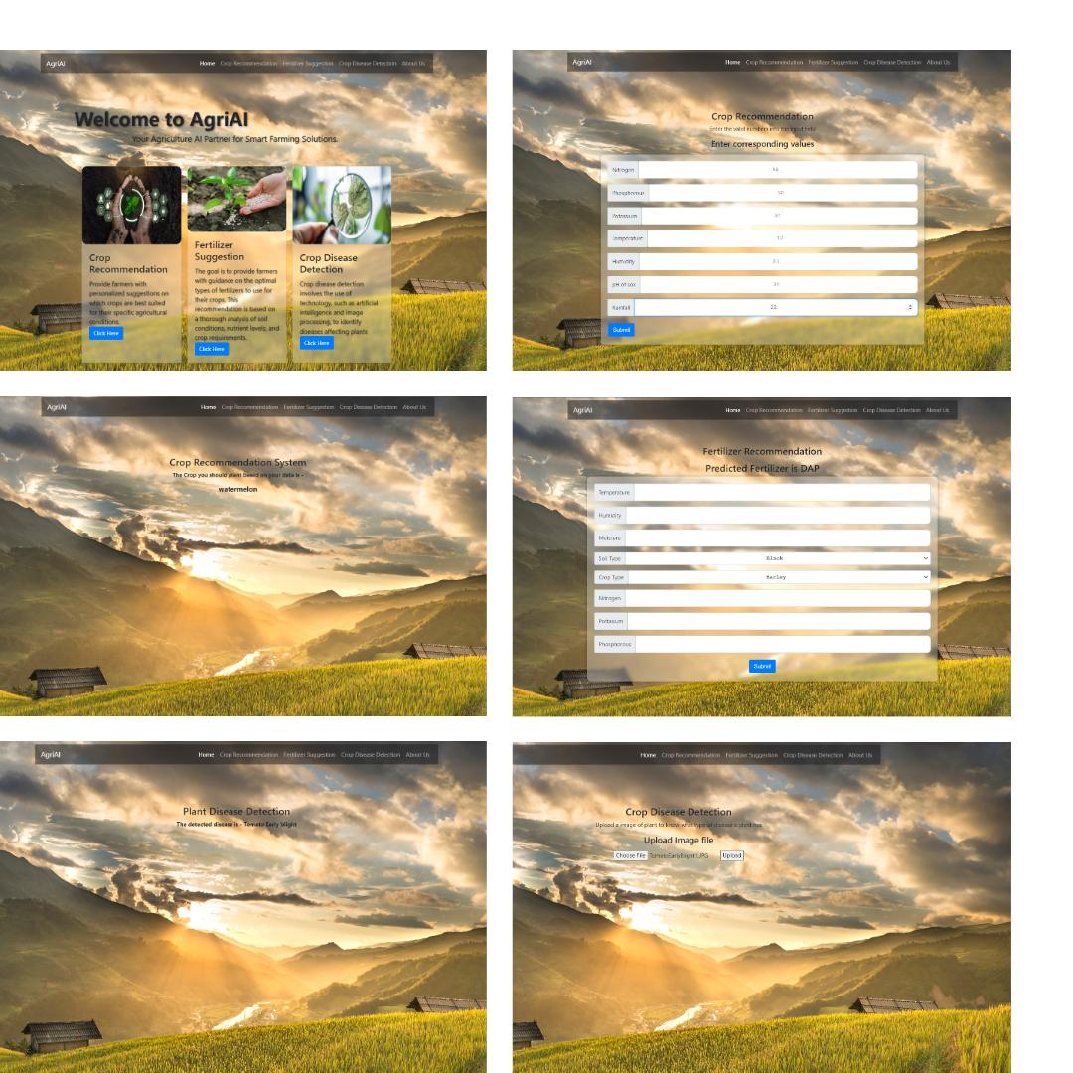
Result / Outcomes

Slide 9
Conclusion
In conclusion, AgriAI represents a transformative force in modern agriculture, integrating predictive analytics, machine learning, and image recognition to address key challenges faced by farmers. The "wow factor" lies in its ability to offer Comprehensive Integration, Visual disease identification within a user-friendly interface. This holistic approach empowers farmers and contributes to the optimization of agricultural practices, promoting sustainability.
As we stand at the intersection of technology and agriculture, AgriAI is a beacon of innovation, fostering resilience, maximizing productivity, and promoting sustainable approaches. Beyond individual farms, its impact extends to agricultural extension services, agribusinesses, government agencies, researchers, and environmental organizations. AgriAI is not just a tool but a catalyst for positive change, emphasizing the harmonious coexistence of technology and nature in the pursuit of global food security.

Slide 10
Future Perspective
Looking ahead, the future perspective for AgriAI is filled with promise and potential. As technology continues to advance, AgriAI can evolve to incorporate even more sophisticated algorithms, expanding its capabilities in predicting crop yields, offering personalized recommendations, and enhancing disease identification accuracy. The integration of emerging technologies like the Internet of Things (IoT) and edge computing could further enhance real-time data collection, providing farmers with instantaneous insights for more proactive decision-making.
Moreover, AgriAI has the potential to become a central hub for agricultural data, fostering collaboration and knowledge-sharing among farmers, researchers, and agricultural stakeholders. The platform could facilitate the development of a connected agricultural ecosystem where insights gained from one region benefit farmers globally. Collaboration with other technological innovations, such as precision farming equipment and drone technology, could amplify the impact of AgriAI, enabling a seamless implementation of optimized farming practices.on of optimized farming practices.

Slide 11
Thank you...!
Notes:
‹#›

